Slide 1
Music Genre Classification
Miniproject as part of CS6301 - Machine Learning
Presented by,
Sarikaa.S - 2018103058
Nidya.M - 2018103046
on
31/10/2020

Slide 2
Objective
To develop a machine learning model that automatically classifies music into its genres based on various different features, instead of manually entering the genre.
To reach a good accuracy so that the model classifies new music into its genre correctly.

Slide 3
Introduction
Music plays a very important role in people’s lives.
Music brings like-minded people together and is the glue that holds communities together.
The purpose of our project is to find a better machine learning algorithm that predicts the genre of songs.
In this project, we aim to build a Convolutional Neural Network model and train them over the audio datasets.

Slide 4
Problem description
Sound is represented in the form of an audio signal having parameters like frequency, decibel, bandwidth etc.
A typical audio signal can be expressed as a function of Amplitude and Time. Some formats are: mp3, WMA (Windows Media Audio) and wav formats.
Many companies such as Soundcloud, Apple Music, Spotify, Wynk. etc use music classification, to place recommendations to their customers.
To be able to do any of the above two mentioned functions, determining music genres is the first step.
To achieve this, we take the help of Machine Learning algorithms.

Slide 5
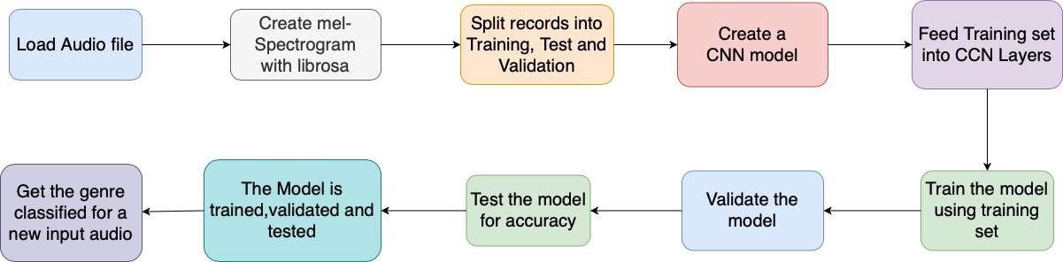
System Architecture

Slide 6
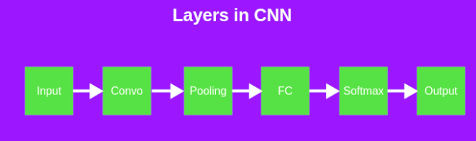
System Architecture
Convolutional Neural Network
There are four convolutional layers with kernel size of 3.
Out channel sets the number of filters or the number of feature map.
One filter produces one output channel.
So, there are 64,128,256,512 filters in the four convolutional layers respectively.

Slide 7
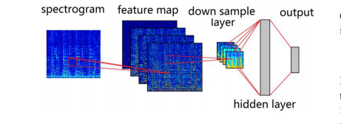
System Architecture
In_features is the length of the flattened output from the previous layer
Out_features is the number of Prediction classes.(Here, 10 genres)

Slide 8
Modules
Configuration
Data preprocessing
Data split
Model
Train
Getting the genre of new input

Slide 9
Input, Output and Algorithm
Module 1 : configuration
Input - labels of genres and paths of audio files are defined
Output - none
Algorithm - none
Module 2 : data preprocessing
Input - Audio files from dataset
Output - melspectrogram
Algorithm – preprocess data

Slide 10
Input, Output and Algorithm
Module 3 : Data split
Input - Extracted features from melspectrogram.
Output - Splitted data into Train,Test and Validation
Algorithm - Data splitting into Train,Test and Validation
Module 4 : model
Input - Extracted features
Output - Created model
Algorithm - Convolutional Neural Networks

Slide 11
Input, Output and Algorithm
Module 5 : Train
Input - Training set data and model from above module
Output - Trained model
Algorithm - Convolutional Neural Networks
Module 6 : Getting the genre of new input
Input - New audio file
Output - Classification of genres in the input audio file
Algorithm – Trained Convolutional Neural Network.

Slide 12
Dataset used :
GTZAN Genre collection dataset by G. Tzanetakis
The files were collected in 2000-2001 from a variety of sources including personal CDs, radio, microphone recordings, in order to represent a variety of recording conditions.
GTZAN contains audio files of the following 10 genres:
Blues
Classical
Country
Disco
Hiphop
Jazz
Metal
Pop
Reggae
Rock
Link : http://marsyas.info/downloads/datasets.html

Slide 13
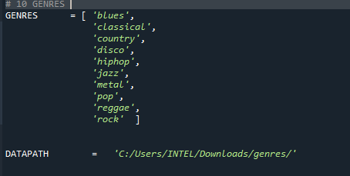
Explanation
There are 10 genres, declared in the configuration module.
And the paths of the data(audio tracks), path of model are also defined here.

Slide 14
Audio processing
The audio processing is done using the librosa library.
First, the audio is loaded with the default sampling rate of 22050 Hz. The loaded audio file is converted into a melspectogram.
y, sr = load(TRACKPATH, mono=True)
S = melspectrogram(y, sr).T
The dataframe has two columns spectrogram and genre.
Each value in the spectrogram column has the shape of 128x128 .
We split the 10,000 records as 7000 for training the model,2000 for validating the model,1000 for testing the model.

Slide 15
Data split-up - Train,Test,Validation
The data is split into train,test and validation sets.
We split the 10,000 records as 7000 for training the model,2000 for validating the model,1000 for testing the model.
Then the model is trained,validated and tested.

Slide 16
CNN :
Now the Convolutional Neural Network model is created.
Layers :
Input layer(128x128)
Convolutional layer
Activation function(RELU)
Batch Normalization
MaxPooling
Fully Connected layer
Output layer(10 genres)
Convolutional layer is also sometimes called as feature extraction layer,where the features of the melspectrogram is extracted.To the part of the mel-spectrogram the convolution operation is applied. That is, the dot product between the input and the filter.The filter is given by the kernel_size.

Slide 17
CNN:
Then the filter is slided over the input by a stride and the convolution operation is performed again.
The output channels will be the input for the next layer.
The pooling layer is used to reduce the spatial volume of the input after convolution. So the maxpooling function is applied to down sample the features.
We flatten the output of the convolutional layers to create a single long feature vector. And it is connected to the output layer, which is called a fully-connected layer.

Slide 18
CNN :
self.conv1 = Conv2d(in_channels=1, out_channels=64, kernel_size=3, stride=1, padding=1)
self.bn1 = BatchNorm2d(64)
self.pool1 = MaxPool2d(kernel_size=2)
We have 4 convolutional layers.
We apply the three steps:
convolutional operation.
batch normalisation + activation function
maxpool the feature maps
This is repeated for the four layers.
Apply softmax function for the output layer.

Slide 19
CNN :
x = F.relu(self.bn1(self.conv1(inp)))
x = self.pool1(x)
Convolutional layer uses RELU activation function.
The softmax function is applied for multi-classification.
The loss was calculated using the categorical crossentropy function.
The prediction for each audio has the percentage of each genre it contains.
The maximum 2 or 3 genres are printed.

Slide 20
Summary of Final Architecture Input(128,128,1)
Layer (type) | Output shape
conv1 | (128,128,64)
pool1 | (64,64,64)
conv2 | (64,64,128)
pool2 | (32,32,128)
conv3 | (32,32,256)
pool3 | (8,8,256)
conv4 | (8,8,512)
pool4 | (2,2,512) = 2*2*512 = 2048
fc1 | 1024
drop1 | 1024
fc2 | 256
drop2 | 256
fc3 (Output layer) | 10

Slide 21
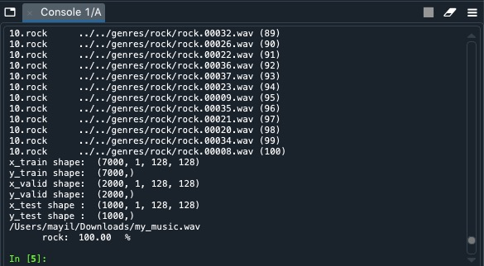
Experimental Results
1. my_music.wav

Slide 22
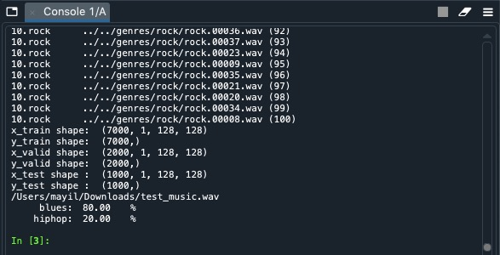
Experimental Results
2. test_music.wav

Slide 23
Analytical Ablation Study
Adding more layers with less stride factor will help extract more features. With more hidden layers, it will give more accuracy.
But we can do that upto a certain extent. After that, instead of extracting features, we tend to ‘overfit’ the data.
Overfitting leads to errors in some or the other form like false positives.
Moreover,as Convolutions increases,so does the computation.

Slide 24
EPOCH | CONVOLUTIONAL LAYERS | ACCURACY
250 | 3 | 60%
250 | 4 | 64%
2)Reducing the number of epochs affects the accuracy.
EPOCH | CONVOLUTIONAL LAYERS | ACCURACY
250 | 4 | 64%
10 | 4 | 26%

Slide 25
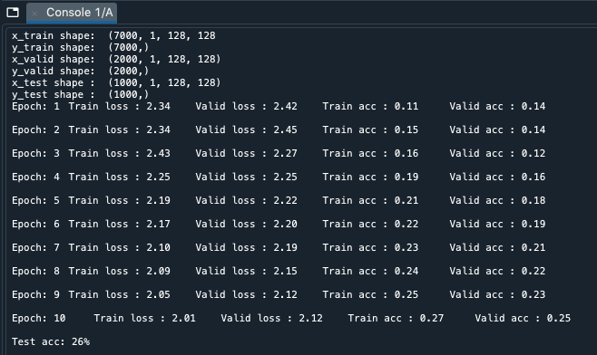
Ablation Study:
When we reduce the number of epochs, we get low accuracy.

Slide 26
Performance Metrics
In order to evaluate the performance of the model, the following metrics will be used.
➢ Accuracy : Refers to the percentage of correctly classified test samples. This metric evaluates how accurate the model's prediction is compared to the true data.
Higher the value of accuracy will give better efficiency in classification.

Slide 27
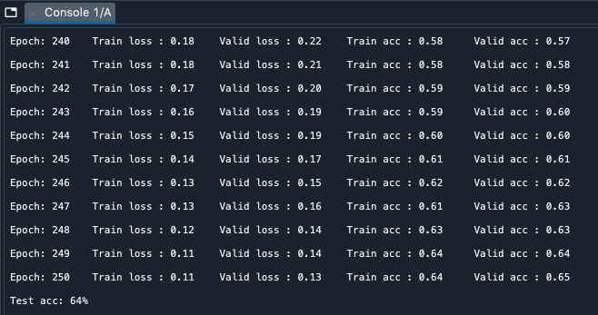
Performance Metrics
We get an accuracy of 64% after training the model for 250 epochs.

Slide 28
Performance Metrics
There are two major challenges with this problem:
Musical genres are loosely defined. So much so that people often argue over the genre of a song.
It is a nontrivial task to extract differentiating features from audio data that could be fed into a model.
The model is learning some of the distinguishing factors of the musical genres, but it is having difficulty with genres that share characteristics with other genres. This goes back to the first problem, and that is the nature of musical genres. They are difficult to distinguish!

Slide 29
Conclusion
This is an automated system for music genre classification.
In this music genre classification project, we aim to develop a classifier on audio files to predict its genre.
By using mel-Spectrogram and training the model using the Convolutional Neural Network, we predict the genre of the test music data.

Slide 30
References
'Convolutional neural networks' by https://en.wikipedia.org/wiki/Convolutional_neural_network
'Understanding of CNN Deep learning' by https://medium.com/@RaghavPrabhu/understanding-of-convolutional-neural-network-cnn-deep-learning-99760835f148
‘Understanding the mel-spectrogram’ by https://medium.com/analytics-vidhya/understanding-the-mel-spectrogram-fca2afa2ce53
G. Tzanetakis and P. Cook, “Musical genre classification of audio signals,” Speech and Audio Processing, IEEE transactions on, vol. 10, no. 5, pp. 293–302, 2002.
T. L. Li, A. B. Chan, and A. Chun, “Automatic musical pattern feature extraction using convolutional neural network,” in Proc. Int. Conf. Data Mining and Applications, 2010.

